Slide 1

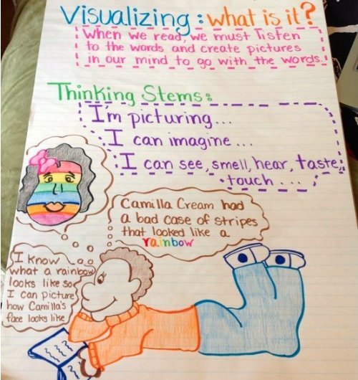
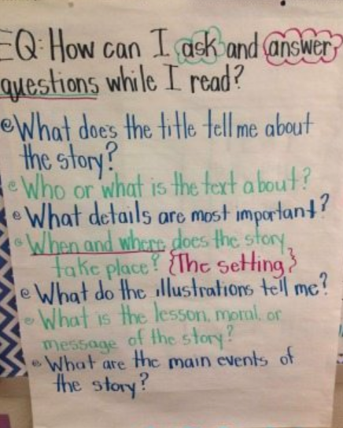
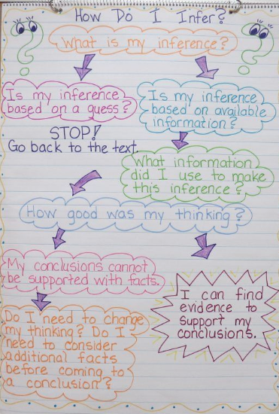
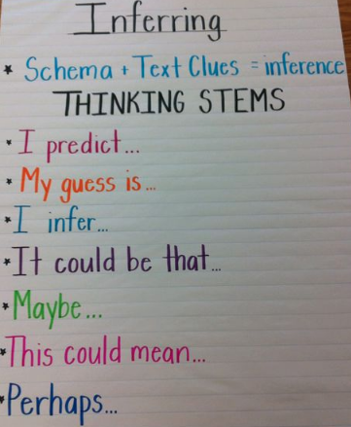
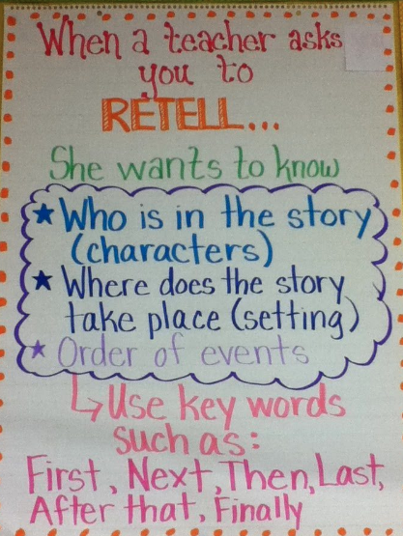
Teaching Reading Comprehension Strategies with
Children with Language Impairments
Morgan Phillips
morganphillips@ufl.edu
Abstract
Recommended Strategies
Examples
Teaching strategies through direct instruction is an evidence-based practice and research reveals that the use of comprehension strategies contributes to reading performance (Gutiérrez-Braojos, & Salmerón-Pérez, 2012; Smith, Borkowski, & Whitman, 2008). This poster communicates how to teach reading comprehension strategies through direct instruction with students with language impairments.
The following strategies are recommended for teaching reading comprehension (Neese, 2017):
Activating Prior Knowledge/Predicting
  Ask students what they already know about a main idea in the text.
  Ask students to make a prediction, explain why they predicted that and see if the prediction is true.
Questioning
  Ask students come up with their own questions about a text and answer questions about important ideas in the text.
  Prompt students with question words, such as “where” and “why”.
  Use modeling to help students develop questions while reading.
Visualization
  Ask students to create a mental image of what is described in a text.
  Model visualization through think-alouds after or while reading text aloud. Facilitate the use of this strategy by giving students an object or scene to examine and then remove that object from sight and have students describe that object.
Monitoring, Clarifying and Fix-Up
  Help students pay attention to whether or not they understand what they are reading, and teach them to re-read it or use other strategies to help them determine what needs fixing and how to fix
  Coach students to know when and what they are not understanding and directly instruct what strategies to use
Drawing Inferences
  Help students generate information that is important to constructing the meaning of the text but is not explicitly stated in the text.
  Help students draw inferences by directing them to key words in the text that lead to understanding
  Model making inferences and give students opportunities to practice
Summarizing/Retelling
  Teach students to briefly describe the main points of the text
  Prompt the use of this skill by asking students to describe the text in their own words to a partner, the class or the teacher.
Text box
Background Research on
Reading Comprehension
Children with language impairments will most likely experience reading comprehension problems that require early intervention (Lance & Barton, 2009).
Reading comprehension strategies are taught to help students internalize (Vygotsky, 1978) the psychological tools of monitoring-control and efficient construction of their own textual representations.
When teachers use direct instruction to teach reading comprehension strategies, they facilitate students’ internalization of these strategies for improving reading comprehension and recall (McKeown, & Beck, 2009; Ruplay, Blair, & Nichols, 2009).
References
Gutiérrez-Braojos, Calixto & Fernandez, Sonia & Salmeron-Vilchez, Purificacion. (2014). How Can Reading Comprehension Strategies and Recall be Improved in Elementary School Students?. Estudios Sobre Educacion. 26. 9-31.
Lance, D. M., & Barton, A. (2009, June 29). Treating Reading Comprehension Deficits in Children with Language Impairment. Retrieved November 18, 2018, from https://www.speechpathology.com/articles/treating- reading-comprehension-deficits-in-1172
McKeown, M. G., & Beck, I.L. (2009). The role of metacognition in understanding and supporting reading comprehension. In D.J. Hacker, J. Dunosky, & A.C. Graesser. Handbook of Metacognition in Education. New York: Routledge
Neese, B. (2017, January 25). The Key to Comprehension: Teaching Reading Strategies. Retrieved November 18, 2018, from https://online.seu.edu/teaching-reading-strategies/
Ruplay, W. H., Blair, T. R., & Nichols, W. D. (2009). Effective teaching instruction for struggling readers: The Role of Direct/explicit Teaching. Reading & Quarterly, 25(2), 125-138.
Smith L. E., Borkowski J. G., & Whitman T. L. (2008). From reading readiness to reading competence: The role of self-regulation in at-risk children. Scientific Studies of Reading, 12, 131-152.
Recommendations
Based on my experience with early elementary students,
I recommend the following:
modeling strategies multiple times during read-alouds
giving students authentic opportunities to practice using strategies immediately after learning them
giving students opportunities to discuss how they use strategies with a partner, encouraging pairs to notice how they used them in the same way and differently

